Slide 1
Autodesk Learning Partner Business Plan
<Insert Program Year> Business Plan Template

Slide 2
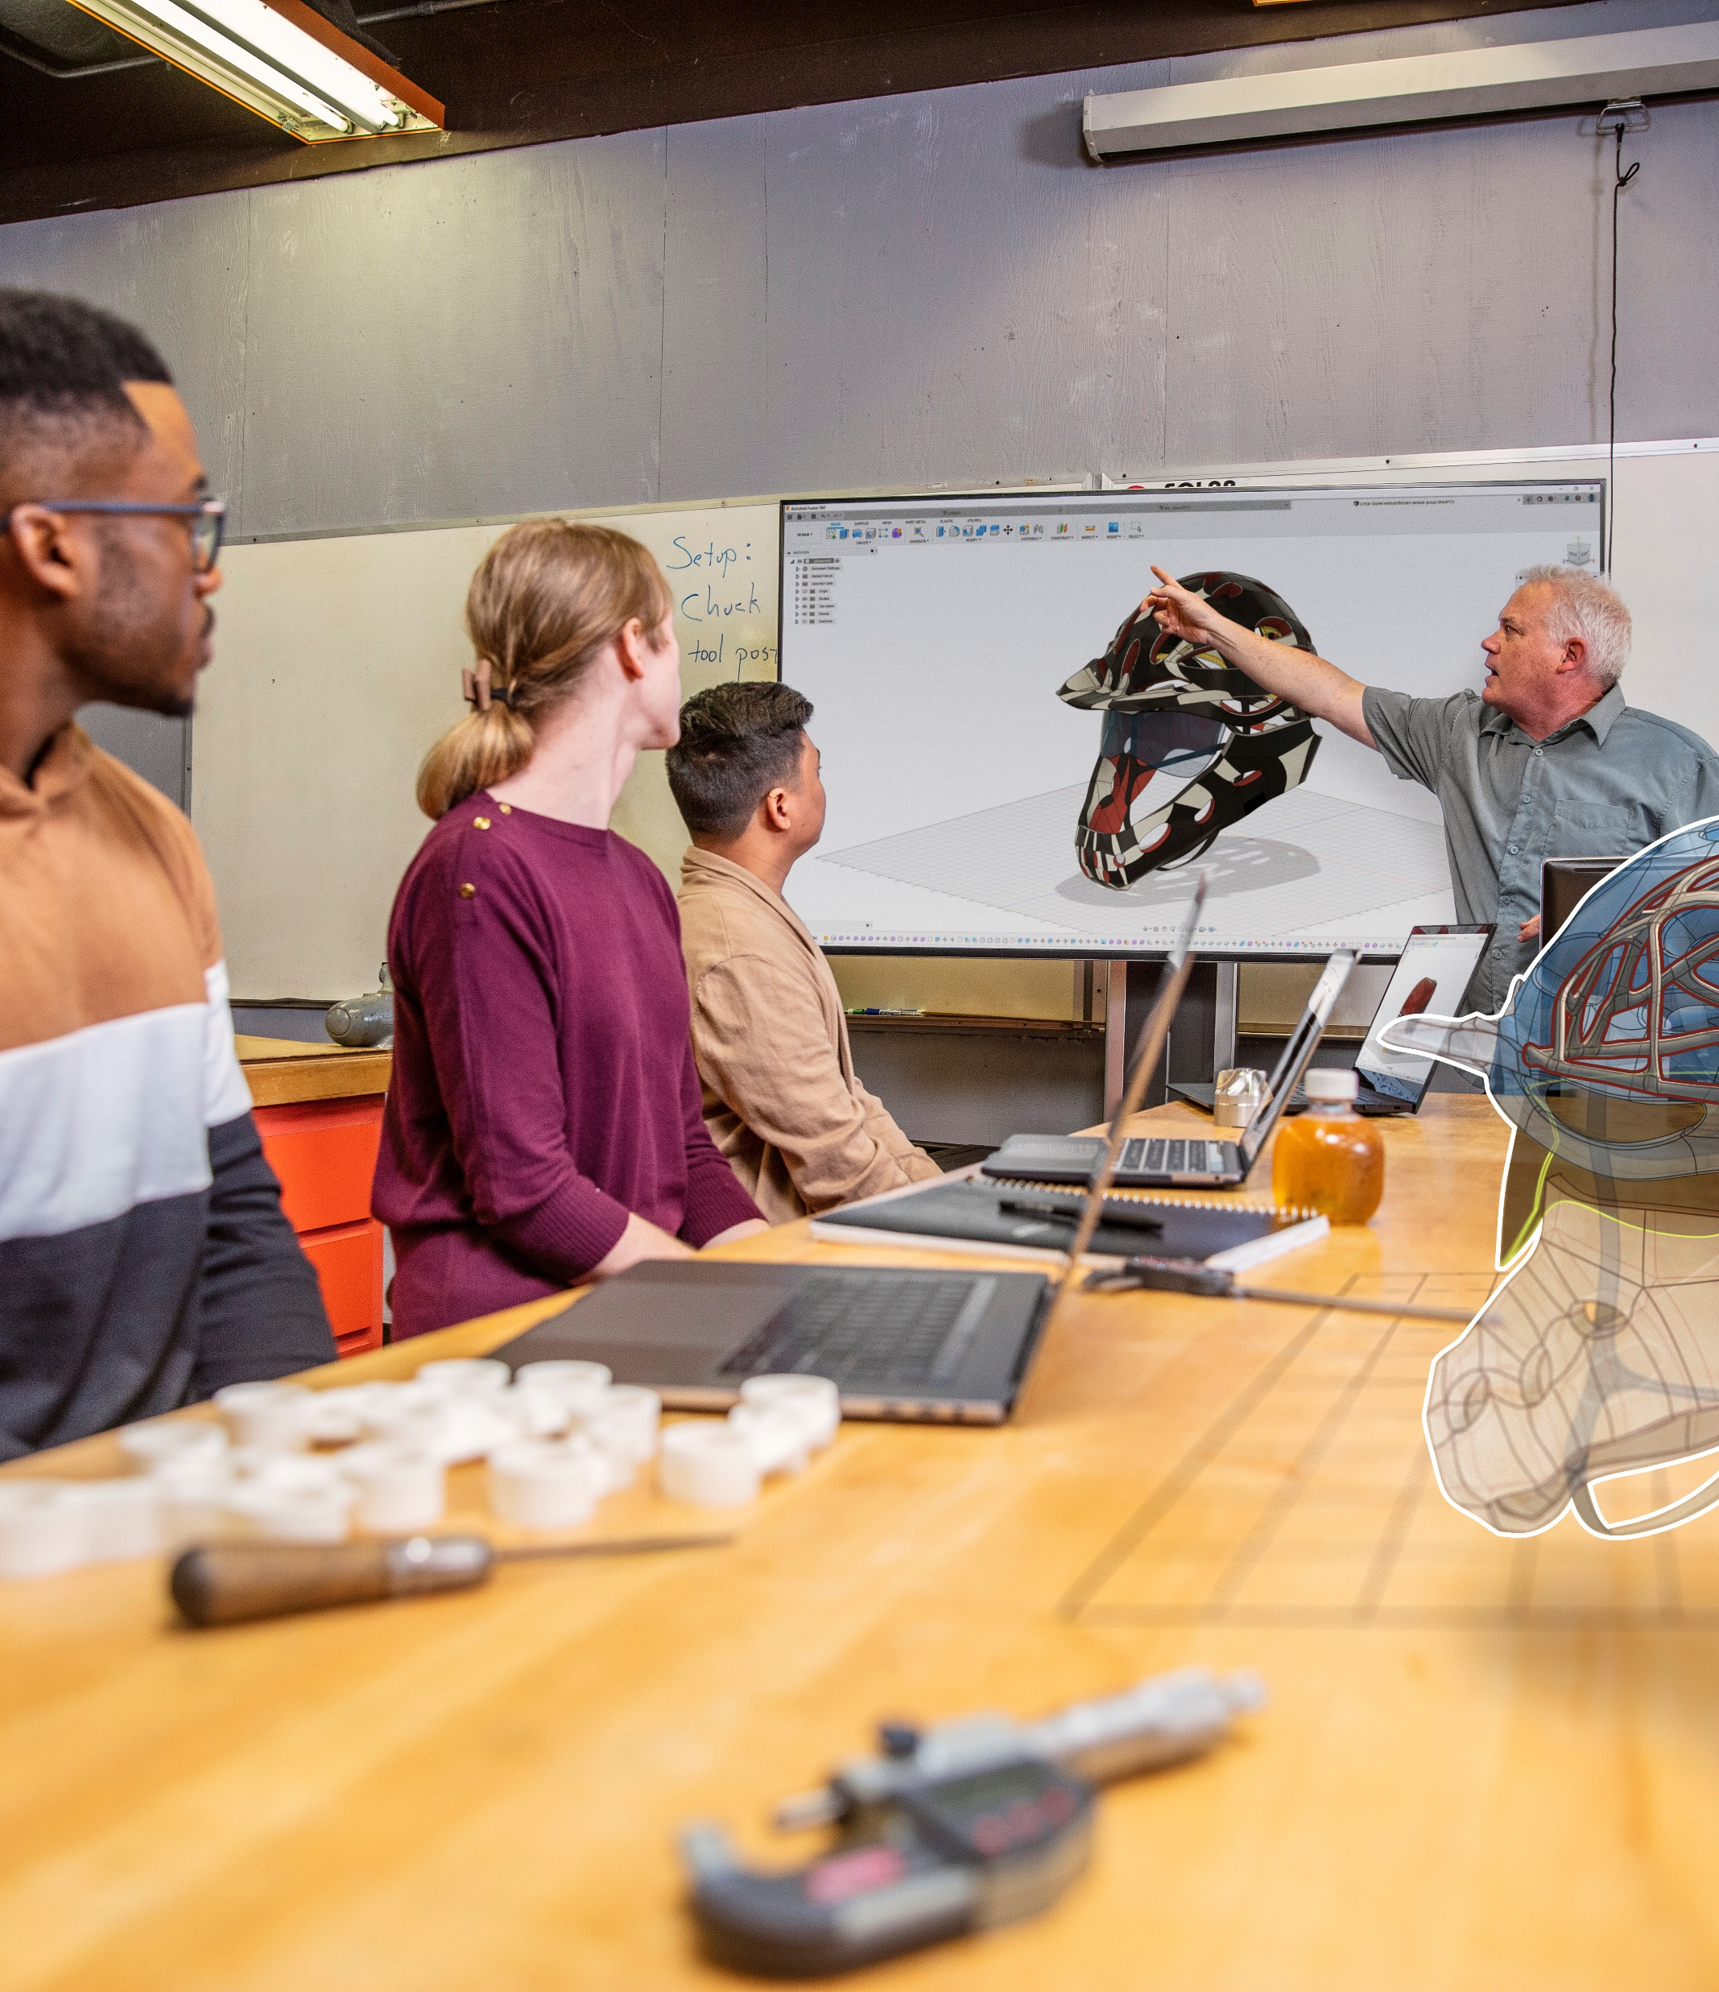
Criteria Checklist
Learning Partner Business Plan
Company Overview
Team Organization
Roles
Responsibilities
Annual Training Forecast
Marketing Initiatives
Appendix – attach any other relevant information

Slide 3

Company Profile
Business overview of your business
Summarize commercial business opportunities
Summarize Education and/or Government opportunities
Industry focus
Architecture, Engineering, Construction (AEC)
Manufacturing
Media & Entertainment
Customer Audience
Current Customer—Professionals, Educators, Students
Target Group(s)—Professionals, Educators, Students
Notes:
May require more than one slide

Slide 4
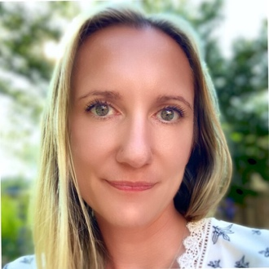
Learning Partner | Team Overview
Provide details for the core team who will support delivery of Autodesk Learning Partner training services to customers.
Name: Role and responsibilities: | Name: Role and responsibilities: | Name: Role and responsibilities: | Name: Role and responsibilities:
Insert Optional Photo here
Insert Optional Photo here
Insert Optional Photo here
Include Organization Chart or key contacts and job roles; alternative slides are in the Appendix.
Notes:
Company Overview
Team Organization
Roles
Responsibilities
Annual Training Forecast
Marketing Initiatives
Appendix – attach any other relevant information

Slide 5
Training Forecast
Learning Partner will use this table to provide an annual forecast for delivery of Autodesk Courses:
Timeline (Fiscal Quarters) | Course Name | Autodesk Product(s) | Learning Environment* | Course Level | Forecast # of Training Participants
Q1/Q2/Q3/Q4 | E.g. Revit Essentials | Revit | Classroom Via Remote Conferencing Mobile Lab On-Campus-Academic Customer | Essentials/ Intermediate/ Advanced/ Certification Prep | # Training Participants
* For more information about permitted Learning Environments, see slide note below or review the ATC or AAP Program Guide— Permitted Learning Environments Section.
Notes:
Permitted Learning Environments:
Learning delivered in Authorized Site
Learning delivered with a Remote Conferencing Tool
Learning delivered with a Live Streaming Platform
Learning delivered in ATC Mobile Lab or at an End Customer Site using an ATC device—
Learning delivered On-Campus to Academic Customers
Learning delivered with Virtualized Software (See ATC or AAP Program Guide, Exhibit—2 for permitted virtualized learning environments.)
E-Learning Course Facilitation (See ATC or AAP Program Guide Exhibit 1—E-Learning Course Requirements)
Certification Exam Facilitation

Slide 6
Marketing Initiatives
Provide insight on your annual marketing plan and how your Company will promote your training business
Time line | Activity Name | Activity Description | Delivery method | Outcomes
Q1/Q2/Q3/Q4 | Activity Name | Promotion campaign for Revit courses | Social media/web/email/mail | # of impressions/ clicks/open rates, etc.

Slide 7
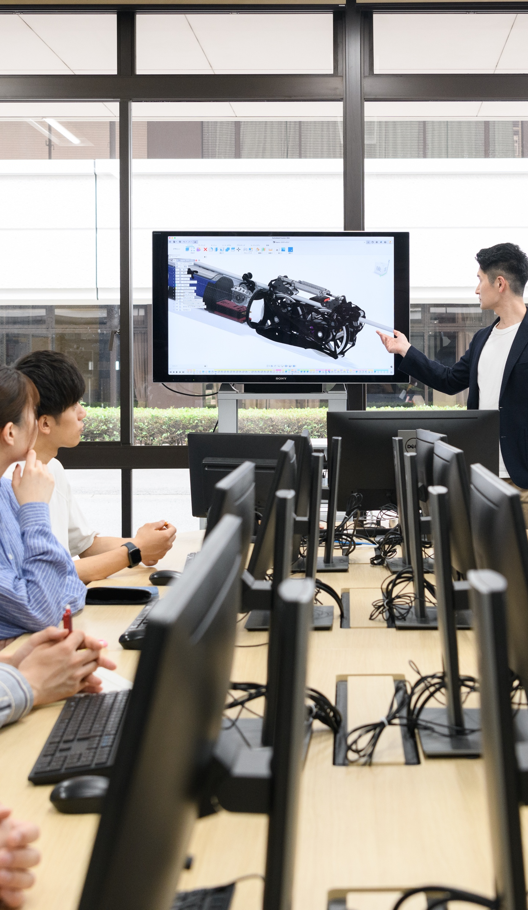
Promote Autodesk Fusion 360®
Autodesk Certified Instructor campaign
Campaign Goal
All active Autodesk Certified Instructors product certified in FY24
Focus on Fusion 360® if instructor’s industry specialization aligns
200 active Autodesk Certified Instructors currently in territory (non-VAR partners)
Participation requirement
Authorized Training Center is meeting their FY24 Program Requirements
Autodesk Certified Instructor is meeting their FY24 Program Requirements
Conduct a minimum of two (2) Approved Courses and / or twenty (20) training evaluation surveys submitted by training participants
Achieve minimum WDT of 87 .5% in the Autodesk Training Evaluation System
Partner and Autodesk Certified Instructor agree to promote Fusion 360 Certification in the region
Campaign Benefit
Opportunity for rapid growth of Fusion 360 awareness and ACP credential
Certification Exam Voucher is ‘free’ for the Autodesk Certified Instructor and for the Authorized Training Center (ATC®)
Opportunity to boost ACI instructor’s confidence and willingness to promote Autodesk Fusion 360
ATC® will offer Autodesk Fusion 360 courses, which leads to increased revenue for ATC and demand for Autodesk Certification exams in the region.
Example of campaign overview

Slide 8
Appendix

Slide 9
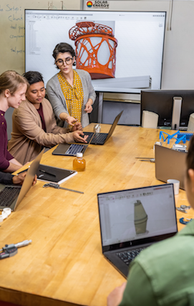
Appendix Guidance
Add any other relevant information that will support the Learning Partner’s Business Plan to the Appendix
Include current examples of your training catalogue, custom course curriculum or training materials used to train Autodesk Products
Include Photographs of Learning Partner’s training facility and training room(s)
Include samples of current marketing materials used to promote your training business

Slide 10
Organization Chart by Region
Leadership
Success Manager
Certified Instructor
Marketing
Operations
Success Manager
Legal
Include Organization Chart or key contacts and job roles.

Slide 11
Key staff and job roles by Region
Name | Title–Job Role | Region or Industry Focus
Include Organization Chart or key contacts and job roles.

