Slide 1

Autodesk Certified Instructor
LinkedIn Community Group
Notes:
https://www.linkedin.com/groups/2654539/

Slide 2
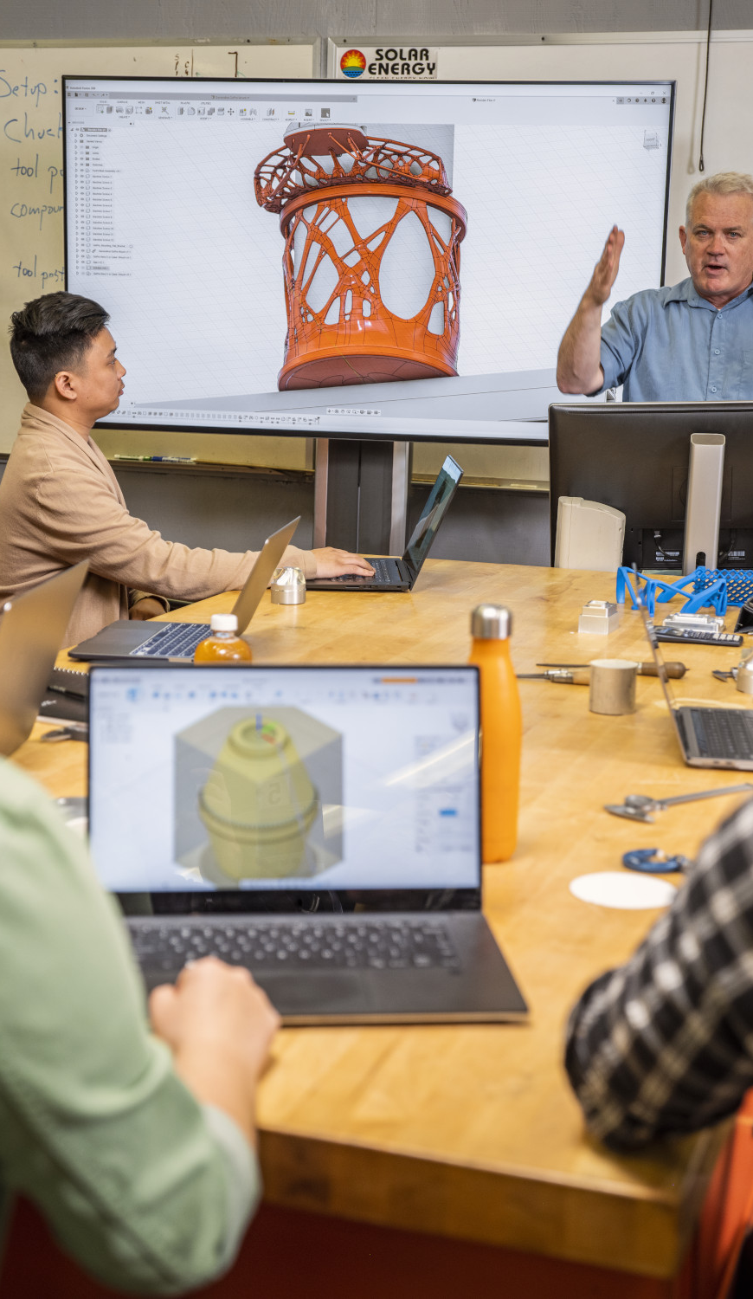

ACI Community LinkedIn group
We’re delighted to invite you to join the new Autodesk Certified Instructor (ACI) Community on LinkedIn.
Across the ACI community, instructors are united by a common goal: to provide high quality learning experiences for students and professionals. We can enhance these experiences when we collaborate and share best practice in learning delivery.
The ACI Community has been created as a place for you to exchange ideas and share knowledge with your ACI peers around the world.

Slide 3

What’s in it for instructors?
Access to a group of highly skilled-industry peers
Opportunity for idea exchange; serves as a catalyst for knowledge exchange
Visibility and connection to Autodesk
Get additional recognition and drive instructor advocacy in Autodesk’s global Learning Community
Be part of shaping the future of the Autodesk Certified Instructor program

Slide 4

Who is eligible to join?
Instructors who have earned an ACI Standard, Silver, Gold, Platinum, or Evaluator credential
Approved Instructors who have received an Instructor ID from your Learning Partner Distributor
Select educators – by Autodesk invitation
Autodesk stakeholders
Autodesk Learning Partner Distributors

Slide 5
What to expect from the ACI Community
Like—Comment—Share
The intent of the ACI Community is to support collaboration between instructors—we encourage you to share your own updates, and to ‘like’ others.
Autodesk and their Learning Partner Distributors will regularly post updates and highlight best practices from around the world—this will spark new ideas and lead to further conversation among the ACI Community members.
Daily
Welcome new members
Discussions, Q&A, make connections
Celebrate success
Weekly
Ongoing posts with Autodesk updates and training industry insight
Weekly summary shared with the group on key stats, contributor of the week, etc.
Monthly
ACI contributor of the month.
Feature regional success stories
Monthly summary and learnings

Slide 6
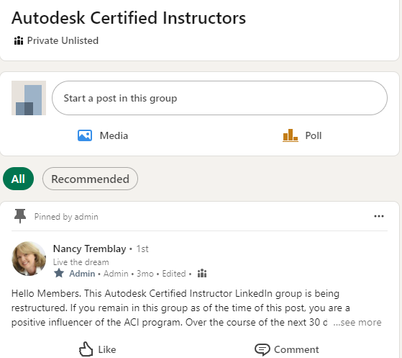
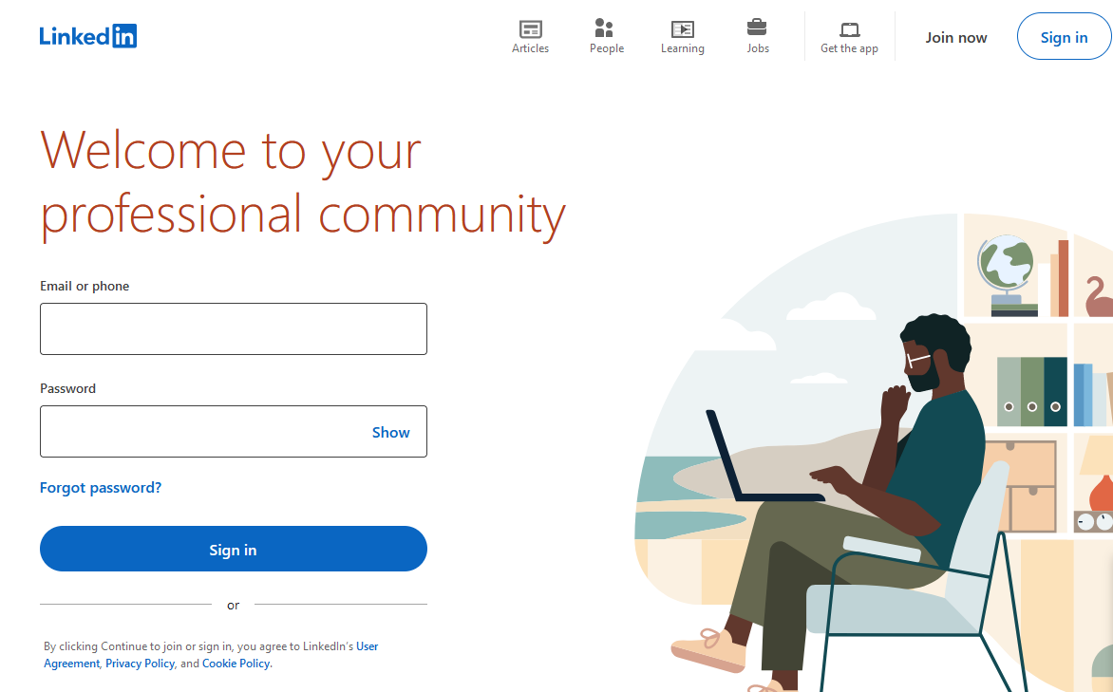
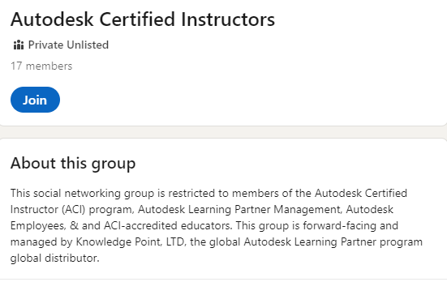
How do I join?
Access the ACI Community on LinkedIn here
1. Access your LinkedIn profile
https://www.linkedin.com/
You will need to create a new LinkedIn account if you do not have an account and professional profile
2. Request to join the community
Go to the ACI Community group here.
Click “Join”.
3. Get started
The community manager will review your request and add you to the group within 2 – 3 business days.
After you are approved to join, you will receive a welcome message including the ACI Community ground rules.

Slide 7

ACI Community Ground Rules
Welcome message sent to all new members
Welcome to the ACI Community—a peer-to-peer network for authorized members of the Autodesk Certified Instructor (ACI) community. This community is not managed by Autodesk, but you can expect to engage with, and view posts from, Autodesk’s LinkedIn members.
The forum exists as a space for helpful conversations, for you to exchange ideas, and to share knowledge with others. We learn from each other through constructive and insightful discussions.
When you join, you must agree to the ACI Community ground rules:
Actively participate, offer constructive advice and ideas to your peers.
Do not use the ACI Community group as a platform for promoting products or your services.
Be polite and respectful to all members. Do not resort to name calling, insults, or any form of personal attack or harassment.
Do not post inappropriate content that could be considered offensive, obscene, or sexually explicit.
Be clear and concise in your posts and be patient with others. This is a global group; although we ask you to post in English, it is not the first language for some members.
Do not deliberately derail conversations by posting the same question repeatedly, changing a thread for your own purposes or starting multiple threads on the same topic.
Help us stay legal and ethical—do not invade another users’ privacy by attempting to collect or share personal information and data without their consent.
Members who do not follow these rules will have their posts hidden or will be permanently removed from the group.

Slide 8


